Slide 1
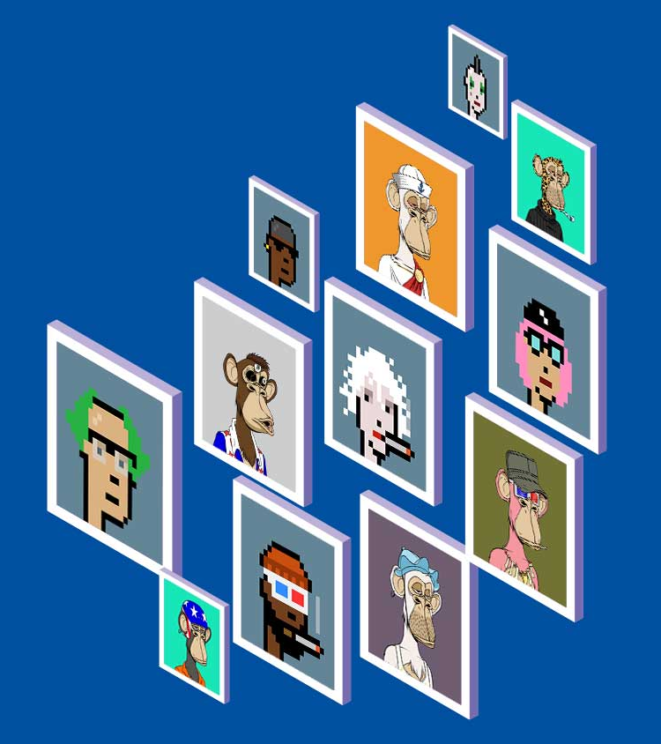
NFT Marketplace
using Blockchain
Under the guidance of
Amartya Chakraborty & Uddalak Chatterjee
By Group 19 Members
SOUMYAK MITRA
ANUBHAV ROUTH
SAYAK KARUI
ARPAN BASU

Slide 2
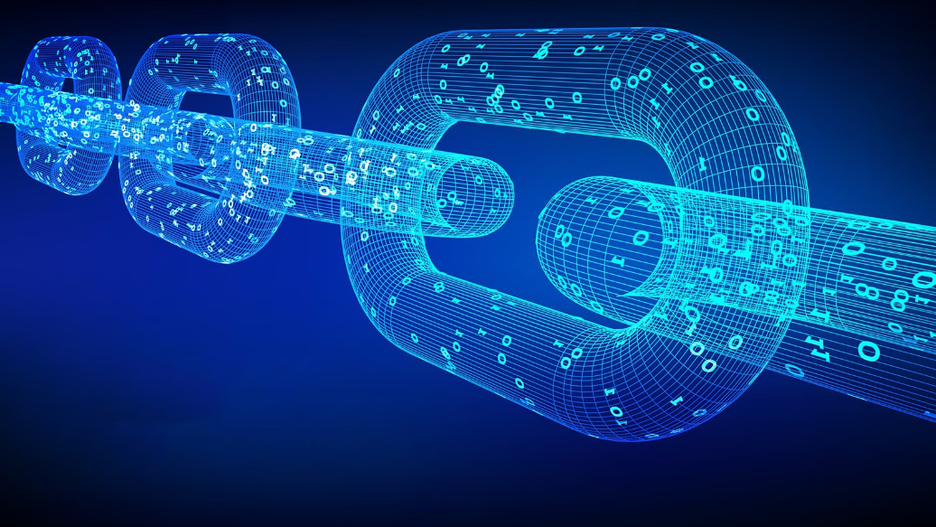
Preventing Digital Assets Piracy and Ensuring Validation, Authentication, and User Ownership
One of the main challenges in the digital assets world is preventing piracy and ensuring validation, authentication, and user ownership.
Our platform is designed to tackle these challenges and provide a secure and trustworthy environment for buying and selling digital assets.

Slide 3
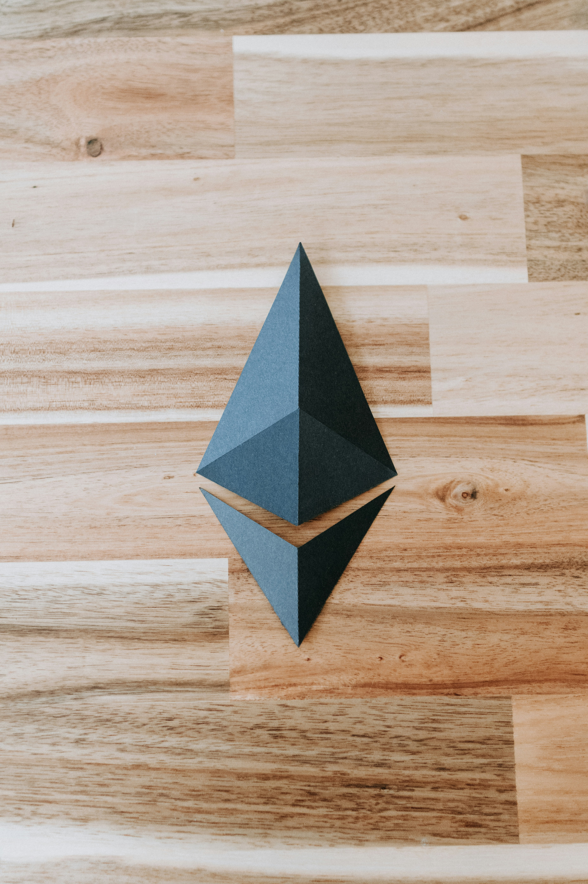
Secure Digital Assets: Comparing Web2 and Web3 NFT Marketplaces
In today's digital landscape, the security and integrity of our assets have become paramount.
Traditional web2 marketplaces have long grappled with issues such as fraud, counterfeiting, and centralized control.
However, the emergence of blockchain technology has paved the way for a new paradigm - the NFT (Non-Fungible Token) marketplace.

Slide 4
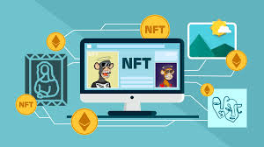
Introduction to NFTs
NFTs, or non-fungible tokens, are a type of digital asset that represent ownership of a unique item or piece of content.
NFTs have gained significant attention in the art market, as they allow for the sale and ownership of digital artwork.
This has opened up new opportunities for artists and collectors alike, as it provides a way to monetize digital art and ensures its authenticity and provenance.

Slide 5
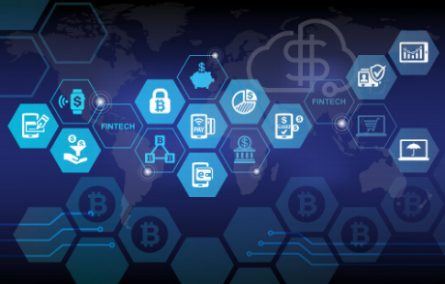
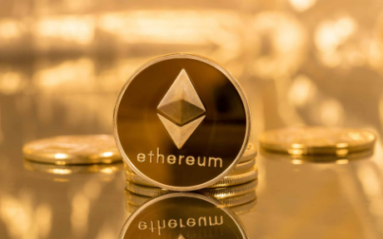
Blockchain: The Foundation of Secure Digital Economies
How Blockchain Works
Benefits of Ethereum
At the core of blockchain technology is a distributed, decentralized digital ledger.
Each "block" in the chain contains a number of transactions.
The decentralized nature of blockchain networks means there is no single point of failure.
Ethereum, the second-largest cryptocurrency after Bitcoin.
Ethereum's key benefits include its programmability.
Additionally, Ethereum's large and active developer community, robust ecosystem of tools and services.

Slide 6
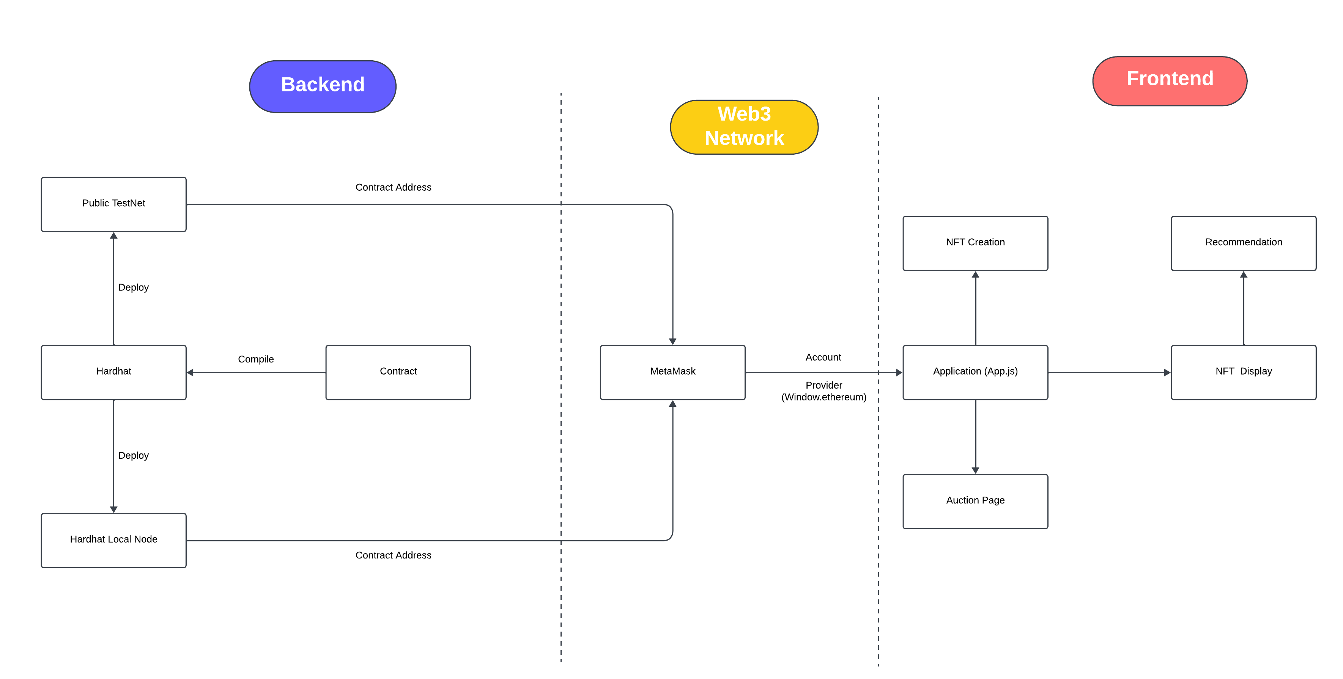
Application Flowchart:

Slide 7
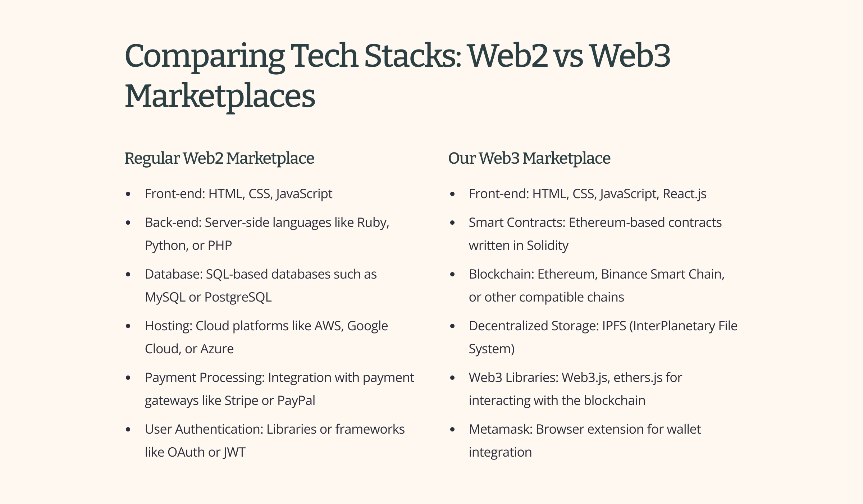

Slide 8
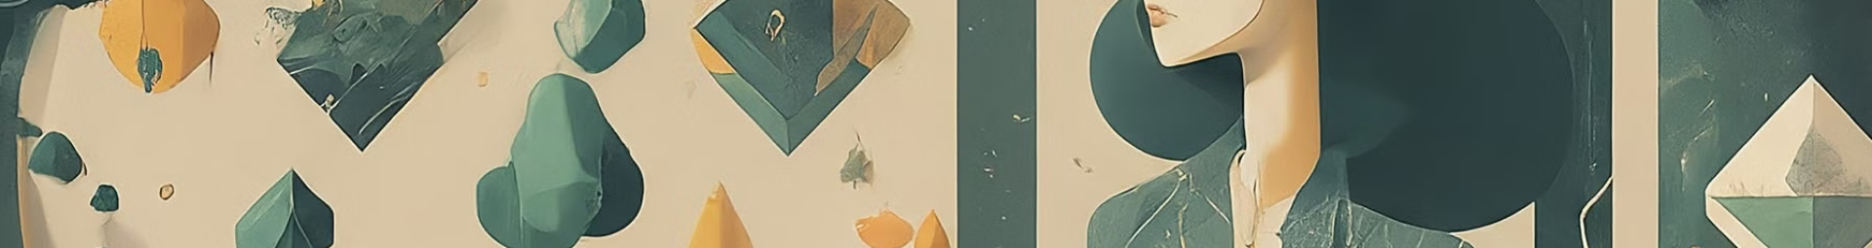
Creating NFTs with OpenZeppelin and IPFS
OpenZeppelin:
A Secure NFT Foundation
IPFS:
Decentralized Storage for NFTs
Combining OpenZeppelin and IPFS
OpenZeppelin is a leading library for building secure and standardized blockchain applications, including NFTs.
By leveraging the ERC-721 token standard, developers can create unique, tamper-resistant digital assets that adhere to industry best practices.
The Interplanetary File System (IPFS) is a decentralized protocol for storing and sharing data.
This approach ensures the NFT's metadata is secure, transparent, and resistant to censorship or central control.
By integrating OpenZeppelin's ERC-721 standard with IPFS for decentralized storage, developers can create a robust and secure foundation for their NFT marketplace.

Slide 9
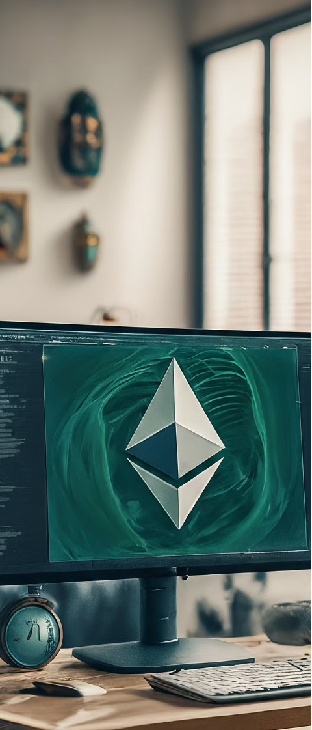
Hardhat: Solving the Goerli and Sepolia Test Net Challenges
1
Goerli and Sepolia Test Net Limitations
Goerli and Sepolia Ethereum test networks provide valuable environments for developers to test their decentralized applications.
These public test networks can be subject to instability, network congestion, and limited access.
2
Introducing Hardhat: A Local Development Environment
Hardhat development environment emerges as a powerful solution.
Hardhat is a local blockchain network allows developers to start Ethereum node on their own machines.
This provides a reliable, isolated, and customizable environment for testing.
3
The Benefits of Hardhat
First, they have complete control over the test network, such as setting gas prices, block times, and other parameters.
Second, Hardhat provides a seamless development experience.
Finally, the local nature of Hardhat ensures consistent and reliable testing.

Slide 10
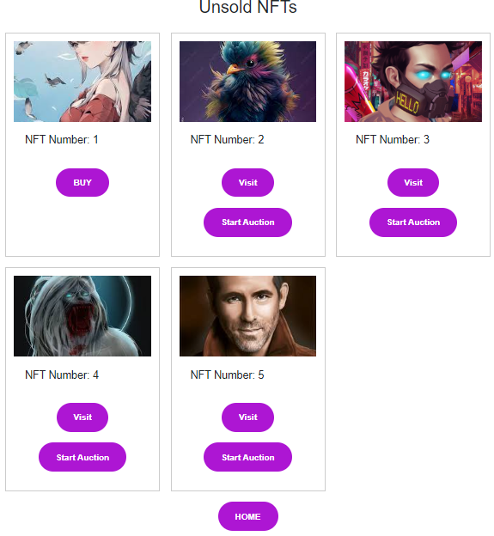
Display and Recommendation of NFTs
NFT Listing Page
The NFT Listing page is the heart of our marketplace, where users can browse and discover a wide range of unique digital assets.
This page features a clean, visually-appealing layout that showcases each NFT's artwork, title and key details.

Slide 11
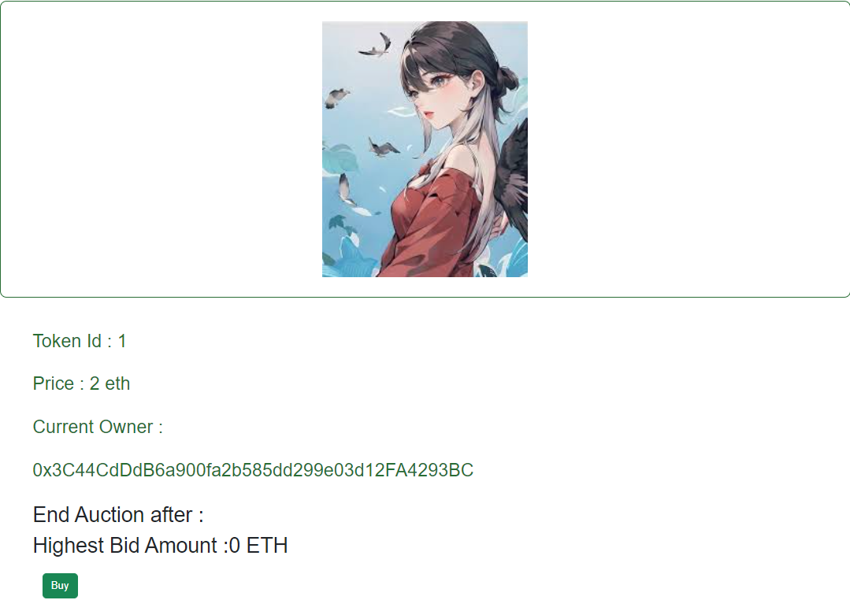
Buying and Selling NFTs on our Marketplace
NFT Detail Page
When users click on a specific NFT, they are taken to the NFT Detail Page, where they can explore the artwork in high detail.
This page provides comprehensive information about the NFT, creation process and auction details.

Slide 12
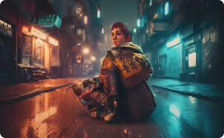
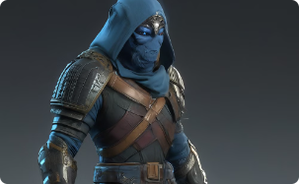
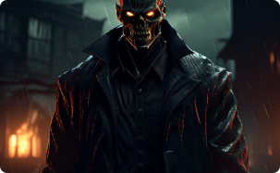
Personalized Recommendations: 6 Categories of NFTs
Anime
Gaming
Horror
Our NFT marketplace offers a captivating selection of anime-inspired digital art.
From fan-favorite characters to original anime-style illustrations.
For the gaming people, our app offers a captivating selection of gaming digital art.
Collectors can own a piece of their favorite gaming franchises or discover unique gaming artwork.
For those with a penchant for the darker side of the digital realm, our app showcases a collection of horror digital art.
From disturbing creatures to unsettling landscapes, these NFTs offer all.

Slide 13


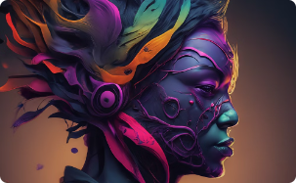
Personalized Recommendations: 6 Categories of NFTs
Movies
Monkeys
Art
Cinephiles will delight in the movie-inspired NFTs available in our marketplace.
With cinematic lighting, dynamic character poses, and meticulously recreated movie settings.
Embrace the playful and whimsical side of the digital art world with our selection of monkey NFTs.
From mischievous primates to serene, contemplative simians.
For the art enthusiasts, our NFT marketplace showcases a diverse collection of abstract and minimalist digital artworks.

Slide 14
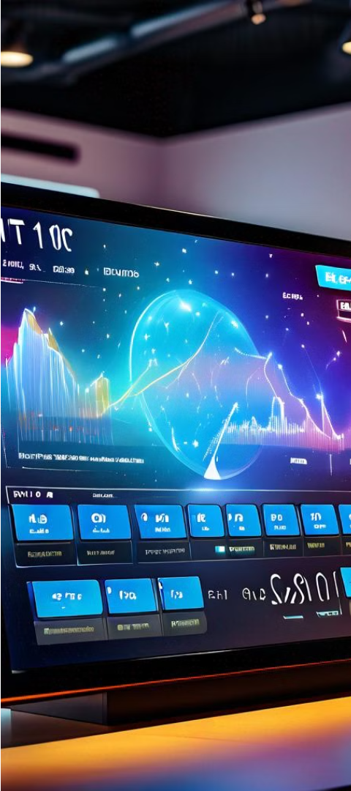
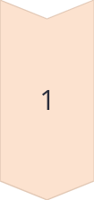


Auction Functionality for NFTs
Start Auction
We offer a seamless auction functionality that allows creators and owners to list their digital assets for competitive bidding.
The Start Auction feature enables users to set the initial price, auction duration, ensuring a fair and transparent auction.
Live Bidding
Once an NFT auction is live, buyers can participate in the bidding process.
Our marketplace provides a real-time, secure, and user-friendly bidding interface.
End Auction
When the auction duration expires, the highest bidder is automatically declared the winner.
The End Auction feature ensures a smooth and verifiable conclusion to the bidding process.

Slide 15
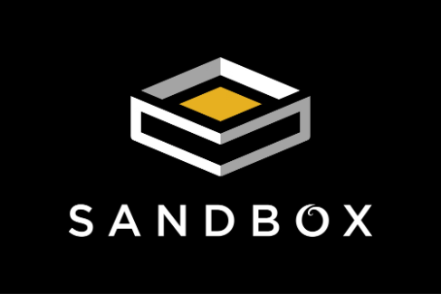
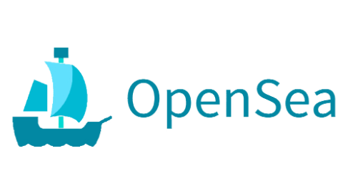
Comparing Our NFT Marketplace to Industry Leaders
As the largest and most established NFT marketplace, OpenSea has set the industry standard for features and functionality.
Our platform aims to match their robust listing and trading capabilities, providing users with a familiar and intuitive experience.
The Sandbox metaverse has pioneered the integration of gaming and NFTs, allowing users to create, buy, and sell unique virtual assets.
While we don't directly compete with the Sandbox's immersive 3D world, our marketplace provides a complementary platform for discovering NFTs.

Slide 16

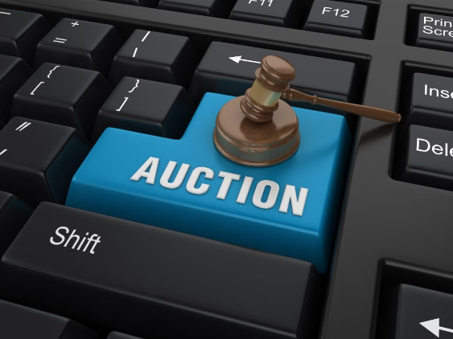
Unique Offerings
Recommendation
Auction System
But what sets us apart is our cutting-edge recommendation system.
Our algorithm analyzes your interests and buying habits to suggest personalized NFTs in six unique categories.
With our auction system, you can discover rare and valuable NFTs, place bids, and track the progress of auctions in real-time.

Slide 17
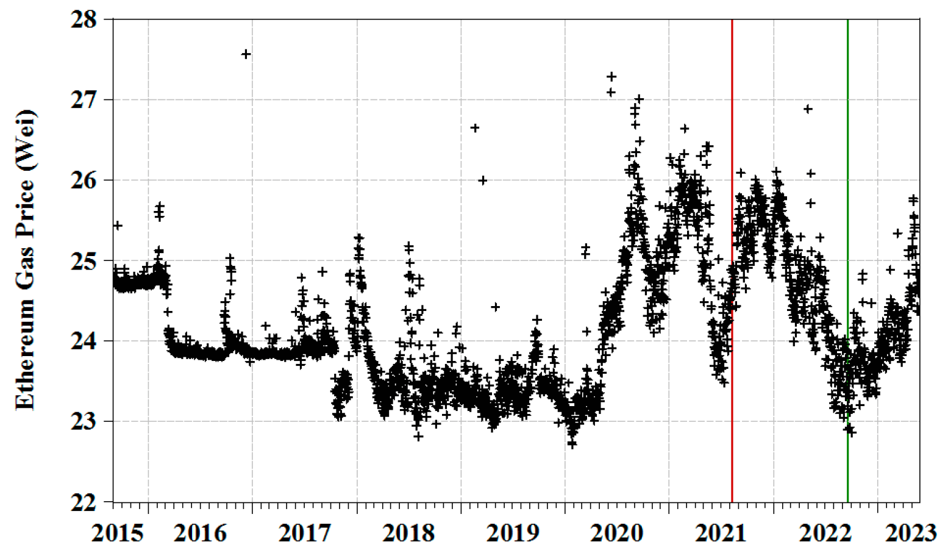
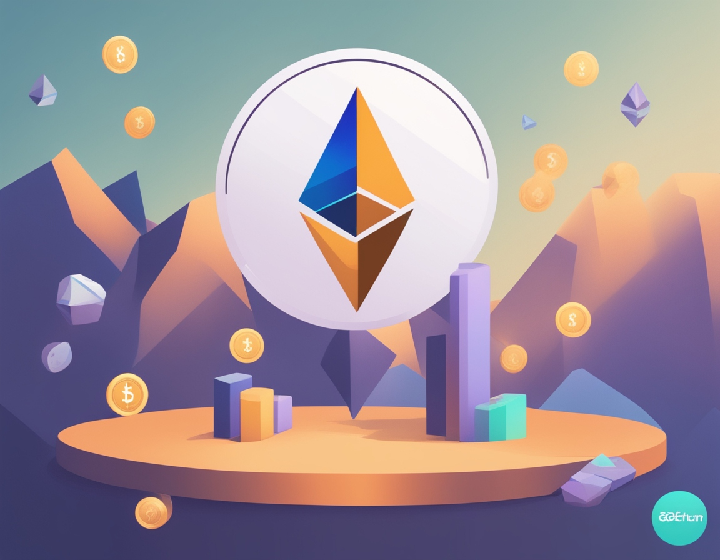
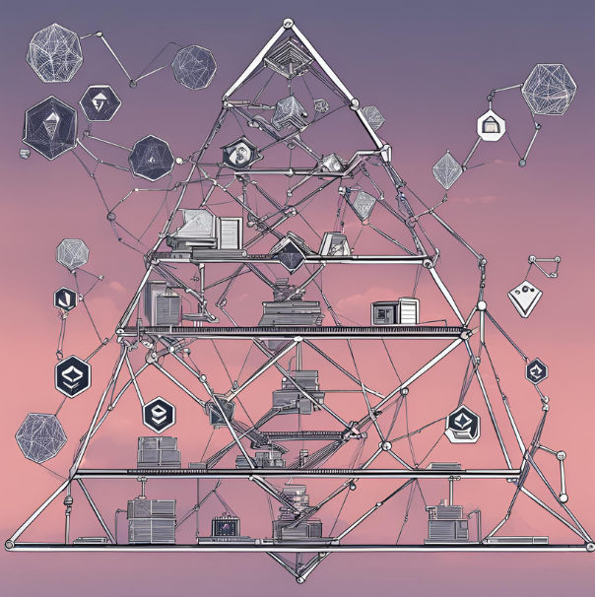
Network and Blockchain Challenges
1
Cost
The cost of transactions on the blockchain was a significant challenge.
In some cases, it was simply not feasible to perform certain operations due to the high costs involved.
2
Transaction Time
Another challenge was the time it took for transactions to be confirmed.
This could be a significant issue for time-sensitive transactions or for users who needed to perform operations quickly.
3
Complexity
Working with blockchain technology necessitates a deep understanding of smart contracts, decentralized consensus, and cryptographic protocols.
The rapid evolution of blockchain technology means constantly adding multiple layer of difficulty to the project.

Slide 18
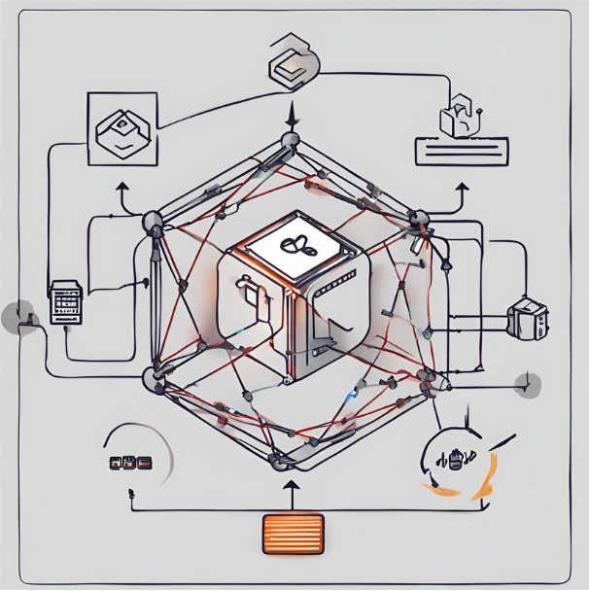
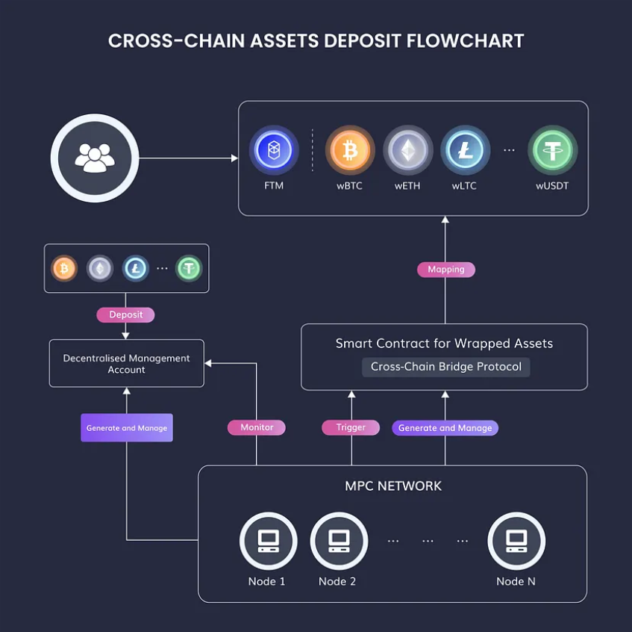
4
Large File Uploading
Blockchain networks often have limitations on the size of data that can be stored in a single transaction.
We had to develop strategies to efficiently handle the uploading and storage of these files while ensuring data integrity and seamless access for users.
5
Cross Platform Exchange
Facilitating cross-platform exchange was another challenge we encountered.
We developed solutions to enable smooth asset exchange between platforms, ensuring compatibility and seamless transactions.

Slide 19
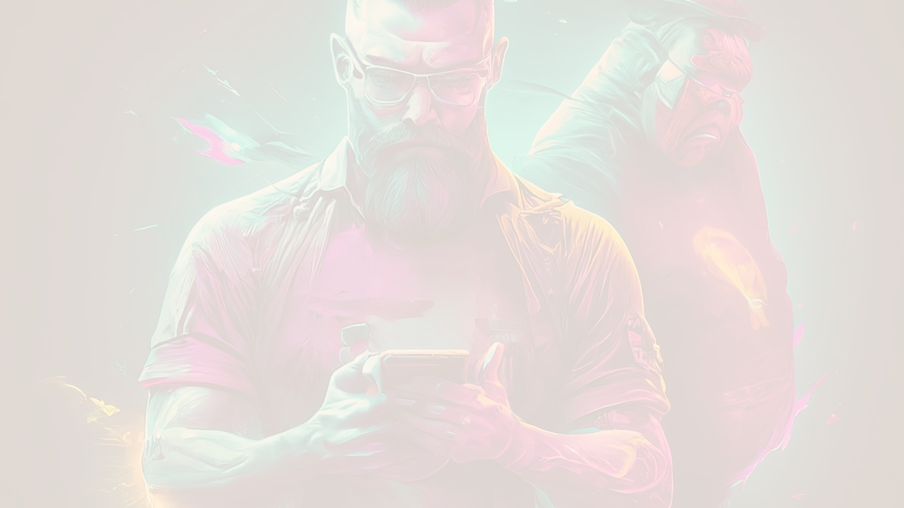
Social Impact of Our NFT Marketplace
1
Empowering Digital Creator
Our NFT marketplace enables digital artists, musicians, and creators to monetize their work and build sustainable careers through a secure platform for minting, selling, and trading digital assets.
We enable creatives to directly connect with their audience and earn fair compensation for their intellectual property.
2
Fostering Digital Ownership
In the digital age, where assets can be easily plagiarized, our NFT marketplace instills a sense of true ownership and scarcity.
We allow users to collect, trade, and display their digital possessions with pride.
This shift towards digital ownership has the potential to reshape how we engage with and value digital content, leading to a more equitable and vibrant digital economy.
3
Promoting Inclusivity
The decentralized nature of our NFT marketplace offers equal access and opportunities for creators and collectors from all backgrounds, fostering a diverse and inclusive digital art community.
This inclusivity allows underrepresented voices to flourish and be celebrated, enriching the cultural landscape and inspiring a new generation of digital creators and enthusiasts.

Slide 20
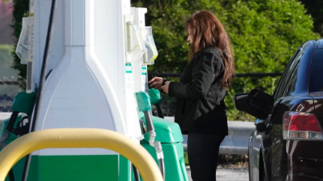
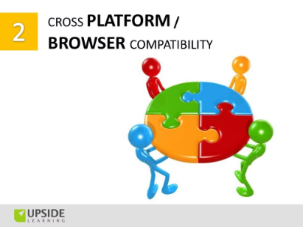
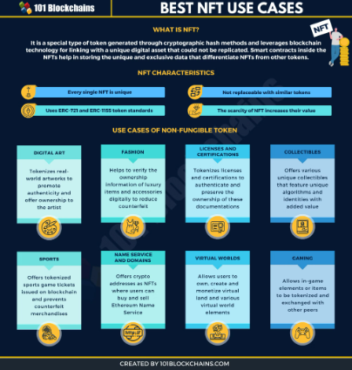
Future Work
1
Gas Cost and Time Efficiency
One of our key focuses for future work is to optimize the gas cost and improve the time efficiency of transactions.
By implementing smart contract optimizations and exploring layer 2 solutions, we aim to reduce transaction fees and enhance the overall user experience.
2
Cross-Platform Compatibility
We plan to further enhance the cross-platform compatibility of our project, ensuring that our blockchain applications work seamlessly across different operating systems and devices.
This includes addressing software dependencies, hardware capabilities, and user interface design to deliver a consistent and user-friendly experience.
3
Wide Range of Use Cases for NFTs
We are actively exploring and expanding the range of use cases for non-fungible tokens (NFTs) on our marketplace.
This includes collaborations with artists, musicians, game developers, and other creative industries to showcase the versatility and value of NFTs in various domains.

Slide 21
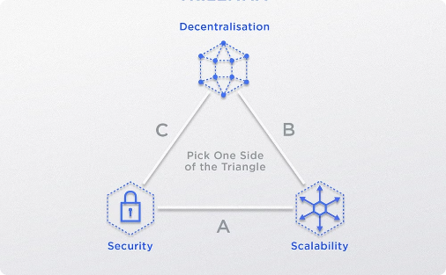
4
Scalability
We are committed to addressing the scalability challenges of blockchain technology.
Our team is actively researching and implementing solutions such as sharding, layer 2 protocols, and consensus algorithm improvements.
Ensuring that our blockchain platform can handle a large number of transactions without compromising security and decentralization.
5
Large File Handling
As the popularity of NFTs continues to grow, we recognize the need for efficient handling of large files associated with digital assets.
Our platform is designed to handle the storage, distribution, and retrieval of large files, leveraging technologies such as IPFS (InterPlanetary File System) to ensure seamless access to high-quality media files that are an integral part of the NFT ecosystem.

Slide 22
Conclusion
As we conclude our exploration of the transformative power of blockchain technology and its application in the world of NFT marketplaces, we are left with a profound sense of the potential that lies ahead. The secure, transparent, and decentralized nature of these digital platforms holds the promise of revolutionizing how we engage with and value digital assets, empowering creators, collectors, and enthusiasts alike. Our NFT marketplace, built upon the solid foundation of Ethereum's blockchain and the robust security of OpenZeppelin's standards, offers a compelling vision for the future of digital ownership and commerce. By seamlessly integrating the latest advancements in blockchain technology, decentralized storage, and personalized recommendation systems, we have created a platform that caters to the diverse interests and passions of our users, from the anime enthusiast to the abstract art aficionado.
As we look ahead, we are excited to witness the continued growth and evolution of this thriving digital ecosystem, where the boundaries between the physical and virtual worlds blur, and where the fundamental principles of scarcity, authenticity, and ownership are redefined. With a steadfast commitment to social impact, we aim to empower digital creators, foster a sense of true digital ownership, and promote inclusivity, paving the way for a more equitable and vibrant digital future for all.
Project Link
https://github.com/sayak23082002/Final-Year-Project

Slide 23
Thank You

